Slide 2
SPARK 2014 – Formal Verification Made Easy
Yannick Moy
October 1st 2015
Notes:
SPARK 2014 is the new version of SPARK, a subset of Ada designed for formal verification.
The past two releases of the SPARK product were based on this new version, so many of you have heard about it.
If you’ve never heard of it, in a sentence SPARK is Ada with contracts + powerful analysis tools. And you can use it whether or not you’re in certification, whether or not you want to combine it with traditional testing.
This presentation is not so much about what SPARK is, but about why using SPARK. Why would you use SPARK? I’ll answer to that question in a few slides.
Besides why using it, we’ll see how easily you can use it. In particular, how it can be easily adopted in your processes, and easily used by your teams.
Hence this bold claim: formal verification IS easy with SPARK 2014.

Slide 3
Easy to adopt, easy to use Multiple use cases Learning SPARK Technical roadmap
Notes:
I’ll present first the features that make SPARK easy to adopt and easy to use.
Then I’ll describe a number of existing use cases.
I will give you the info on how to learn to use SPARK.
And we will finish with a focus on what’s cooking for the next release and beyond.

Slide 4
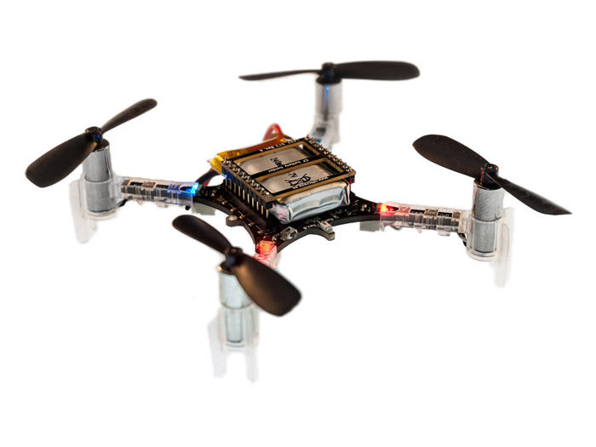
Crazyflie 2.0
1800 sloc stabilization in C
+ FreeRTOS
+ …
Notes:
But before that, here is a story that supports my bold claim.
This is the Crazyflie, a small leisure drone, originally programmed in C on top of FreeRTOS + libraries/drivers/etc all in C.

Slide 5

2 months later…
Crazyflie 2.0
1800 sloc stabilization in C
+ FreeRTOS
+ …
Crazyflie in Ada/SPARK
2100 sloc stabilization in SPARK
proved no run-time errors!
+ FreeRTOS
+ …
Notes:
Here is our past intern Anthony Leonardo Gracio.
Anthony had little knowledge of Ada and no knowledge of SPARK or of any static analysis tools prior to his internship.
Yet, in 2 months, Anthony rewrote completely the stabilization code of the Crazyflie in SPARK, and he proved absence of run-time errors on the SPARK code.
And the drone was flying better at this stage.

Slide 6
5 months later…
Crazyflie 2.0
1800 sloc stabilization in C
+ FreeRTOS
+ …
Crazyflie in Ada/SPARK
2100 sloc stabilization in SPARK
proved no run-time errors!
+ Ravenscar (safe tasking)
will prove
no concurrency errors!
Notes:
Just give him 3 more months, and he rewrote the complete firmware in SPARK and Ada.
And now we expect to prove absence of concurrency errors with the upcoming version of SPARK that supports Ravenscar (safe tasking in Ada)
Anthony’s assessment of using SPARK was that it was intuitive! Not the typical feedback from people who use formal methods tools for the first time.
You’ll see a demo of the Crazyflie in the next talk btw.

Slide 7
Easy to Adopt
Gradual adoption
SPARK is just Ada!
Some units in SPARK, others in Ada
Inside units, parts in SPARK and parts in Ada
Integrated in developer’s toolbox
Based on GNAT projects
SPARK tools integrated in GPS and Eclipse GNATbench
Notes:
Two features make SPARK easy to adopt in your processes:
SPARK is Ada!
SPARK is AdaCore technology!

Slide 8
Easy to Use
Incremental benefits
Usable without upfront work (no contracts)
Increasing benefits with more contracts
Highly interactive
Run at different levels of granularity (down to single line)
Run at different levels of power
Get precise results in GPS or GNATbench
Features to query results (paths, counterexamples)
Notes:
Two features of SPARK make it easy to use:
SPARK listens to you!
SPARK talks to you!

Slide 9
Multiple Use Cases (1/2)
Safe coding standard for critical (embedded) software
Increases portability across compilers/platforms
Prove absence of run-time errors (AoRTE)
In replacement of robustness testing
Equivalent to exhaustive testing
Few contracts required
Typically 95% - 98% of RTE proved automatically
Proof can be completed by testing
Notes:
We have identified a number of use cases for SPARK. Here are the 5 more common ones.

Slide 10
Multiple Use Cases (1/2)
Safe coding standard for critical (embedded) software
Increases portability across compilers/platforms
Prove absence of run-time errors (AoRTE)
In replacement of robustness testing
Equivalent to exhaustive testing
Few contracts required
Typically 95% - 98% of RTE proved automatically
Proof can be completed by testing
Notes:
Focus on how proof and test can be combined in 2 slides.

Slide 11
Multiple Use Cases (2/2)
Prove correct integration between components
In replacement of defensive coding
Simple contracts are needed
Prove functional correctness (including input partitioning)
In replacement of unit testing
More complex contracts are needed
Safe optimization of run-time checks

Slide 12
Combining Proof and Test
At the level of individual runtime checks
Possible RTE covered by tests
Also the approach in VectorCAST with CodePeer
Between proof and integration testing
Contract used for AoRTE at unit level
Same contract used for integration testing (no unit tests)
Between proof and unit testing
Contract as boundary between proof and unit test
Very relevant in DO-178C context for avionics

Slide 13
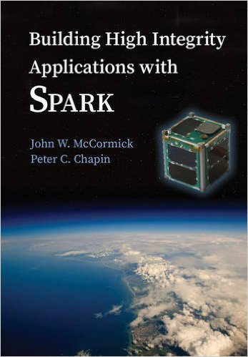
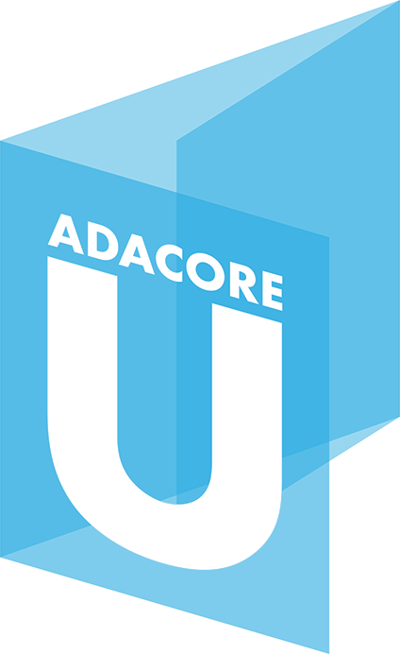
Learning SPARK: Contracts
Overview of SPARK Language (SPARK User’s Guide)
Subprogram contracts
Package contracts
Type contracts
Tagged Types and Liskov Substitution Principle
SPARK Book (McCormick & Chapin)
SPARK Courses
Tutorials, webinars, trainings
AdaCore University (u.adacore.com)
Notes:
There are two things to learn to use SPARK:
How to write contracts
How to use the analysis tool called GNATprove
We have many resources for learning both.

Slide 14
Learning SPARK: GNATprove
Formal Verification with GNATprove (SPARK User’s Guide)
Running the tool and viewing results, but also…
How to use GNATprove in a team
How to write subprogram contracts
How to investigate unproved checks
…
GNATprove by Example (SPARK User’s Guide)
SPARK Book and Courses

Slide 15
In The Next Release
New language features
Support for Ravenscar profile of tasking
Support for ghost code
Support for type predicates
Improved provability
New provers CVC4 and Z3 (in addition to Alt-Ergo)
Much better handling of modular integers and bitwise arithmetic
Improved interaction
Generation of counterexamples when not proved
Notes:
Here are the main new features in the next release, SPARK Pro 16:
There are very important new language features
The largest one being the support for the Ravenscar tasking profile, that is, safe tasking in Ada
Ghost code is a unique feature of SPARK, which allows nonintrusive instrumentation of code for verification purposes. That can be static verification, but also dynamic verification. It is fully supported in the next GNAT release, so it may be interesting even if you’re not a SPARK user.
Type predicates provide a very fine-grain mechanism for stating invariants of your data. They are now supported in SPARK, so you can prove your data invariants are never violated.
We have notably improved proof results
In particular through the addition of two new provers, CVC4 and Z3.
But also by better handling modular integers and bitwise arithmetic
We have finally implemented an important interaction feature that users always wanted: counterexamples

Slide 16
In The Next Release
New language features
Support for Ravenscar profile of tasking
Support for ghost code
Support for type predicates
Improved provability
New provers CVC4 and Z3 (in addition to Alt-Ergo)
Much better handling of modular integers and bitwise arithmetic
Improved interaction
Generation of counterexamples when not proved
Notes:
And I’m going to focus now on two of these features:
Ghost code
And counterexamples

Slide 17
Support for Ghost Code
^{contracts}
ghost
functions
with assertions
+
^{code}
compile
^{executable}
used in formal + test
Notes:
Here is some code with contracts, which is compiled together to produce an executable when assertions are enabled.
Ghost functions can be used in contracts only, typically to define queries only useful in verification.
This is useful for both formal verification and for testing.

Slide 18
Support for Ghost Code
^{contracts}
ghost
functions
with assertions
+
ghost
variables,
types,
procedures
^{code}
compile
^{executable}
used in formal + test
Notes:
That’s not all.
Ghost variables, types and procedures can be used directly in the code, also to compute data only useful for verification.

Slide 19
Support for Ghost Code
^{contracts}
ghost
functions
with assertions
+
ghost
variables,
types,
procedures
^{code}
compile
^{executable}
removed in final build
Notes:
What’s critical is that, after verification, all the ghost code disappears from the final executable when you compile without assertions.
This is how ghost code provides nonintrusive instrumentation of code, which may be useful even if you don’t use SPARK.

Slide 20
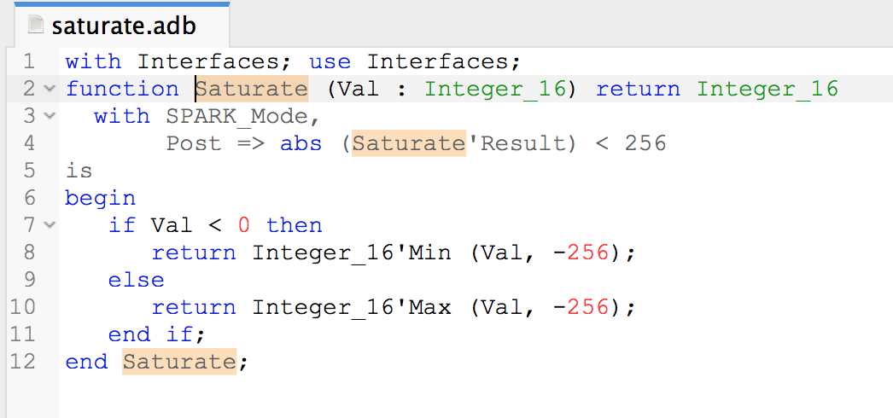
Generation of Counterexamples
Notes:
Turning to counterexamples, here is an example of code which returns the saturated value of its argument:
If the argument is between -256 and 256, it is returned unchanged
Otherwise, -256 is returned for negative arguments, and 256 is returned for positive arguments
It turns out this code is full of bugs… so let’s try to prove it.

Slide 21
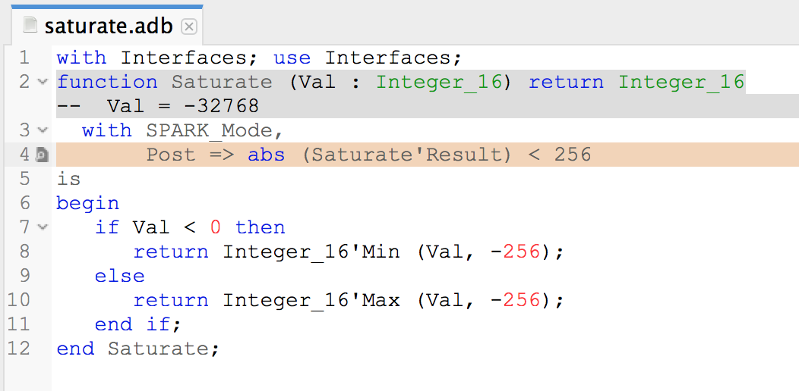
Generation of Counterexamples
saturate.adb:4:16: medium: overflow check might fail
Notes:
GNATprove issues a message that tells us the abs operation on line 4 (in the postcondition) might fail on overflow. That’s indeed the case when the argument of abs is the minimal integer value.
… and that’s exactly what GNATprove tells us here, with the value of counterexample that it displays: Val = -32768
If you follow the program’s logic, this value causes the first branch of the if to be taken, so the minimum between this value and -256 is returned…
Wait there is an error here, it should be the maximum!

Slide 22
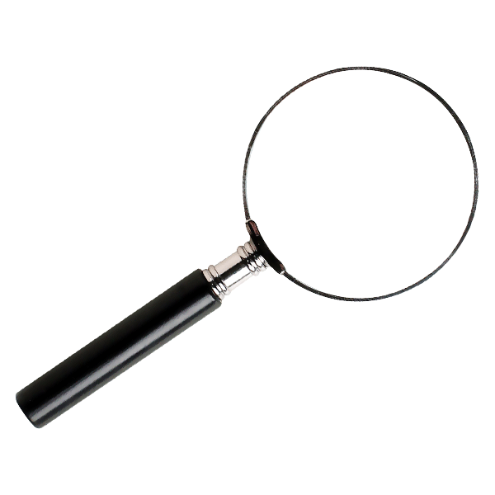
Generation of Counterexamples
saturate.adb:4:16: medium: overflow check might fail
Notes:
Indeed, the error was that Min and Max were switched here. Let’s fix that and rerun GNATprove.

Slide 23
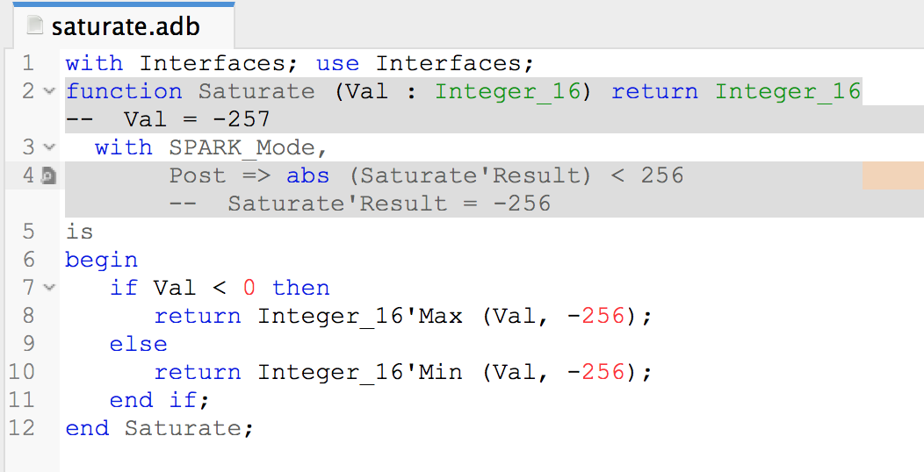
Generation of Counterexamples
saturate.adb:4:16: medium: postcondition might fail
Notes:
This time, GNATprove issues a message that tells us that the postcondition on line 4 may fail.
It would be harder this time to know just by looking at the code what might go wrong, but GNATprove again shows a counterexample:
When Val is -257 on entry, then the first branch of the if is taken, and the function returns -256, as shown in the counterexample displayed, which looks correct!
But the postcondition requires that its absolute value is strictly less than 256!

Slide 24
Generation of Counterexamples
saturate.adb:4:16: medium: postcondition might fail
Notes:
That’s the error here, the postcondition is too restrictive, it should be less than or equal.

Slide 25
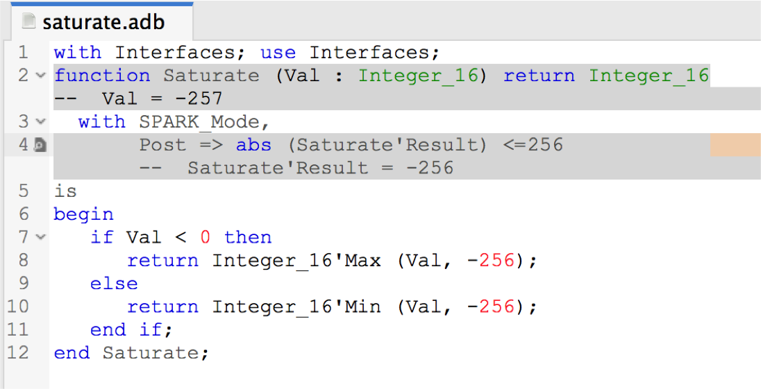
Generation of Counterexamples
saturate.adb:4:16: medium: postcondition might fail
Notes:
So we fix that, and we can continue interacting this way to find the next bug…

Slide 26
Beyond The Next Release
New language features
Support for type invariants
Support for simple pointers
Improved provability
Better handling of floats
Integration of CodePeer static analysis in GNATprove
Improved interaction
Better integration between SPARK and C
Metrics and indicators for formal developments
Notes:
What are we looking at beyond SPARK 16? We’re planning improvements in all directions:
New language features, to support Ada 2012 type invariants, and some simple pointers
More automatic proofs, with a better handling of floats and an integration of our CodePeer static analyzer. The goal of this integration is both to
Prove checks that would not be proved by provers Alt-Ergo, CVC4 and Z3.
Prove the same checks as Alt-Ergo, CVC4 and Z3 but faster! Typically, the kind of static analysis done in CodePeer can prove range and overflow checks very quickly.
Better integration between SPARK and C, and providing metrics for formal developments, in the context of a collaboration with Squoring Technologies

Slide 27
SPARK Is Good For You…
If you want to get guarantees about your software
At a reasonable cost
With your existing team / tools / processes
… We’re here to help!

Slide 28

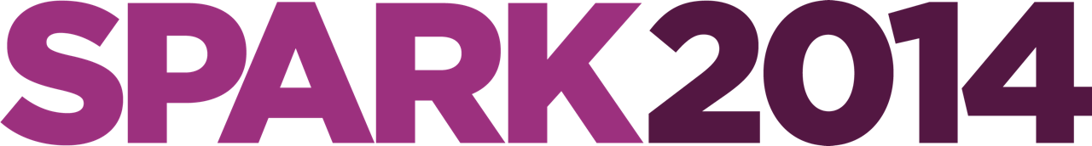
Resources
SPARK Pro webpage
http://www.adacore.com/sparkpro
SPARK community page
http://www.spark-2014.org
SPARK User’s Guide
http://docs.adacore.com/spark2014-docs/html/ug
AdaCore University
http://u.adacore.com

